Slide 1
Sparse vs Dense Classification
Camille

Slide 2
Datasets
Breast cancer – Wisconsin – small number of features / low dimensions
n=699, p=8
Dense data – lots of data to represent each feature
2 predicted classes: benign and malignant
CAD – large number of features / high dimensions
n = 303, p = 54
More sparse data – less data to represent each feature
2 predicted classes – presence or absence of coronary artery disease (CAD)
R. Alizadehsani et al., “A data mining approach for diagnosis of coronary artery disease,” Computer Methods and Programs in Biomedicine, vol.111, no.1, pp.52-61, Jul. 2013.

Slide 3
Analysis Methods / Curse of Dimensionality
Logistic Regression and Sparse Logistic Regression
Too many features results in overfitting the model
Classifiers that model decision boundaries very accurately are less prone to overfitting – logistic regression will be less prone to overfitting
When n=p or n<p logistic regression still becomes biased
We can add a penalty to the equation similar to a lasso penalty with sparse logistic regression. This will force some less important variables to have coefficients of 0 and simplify our model.

Slide 4
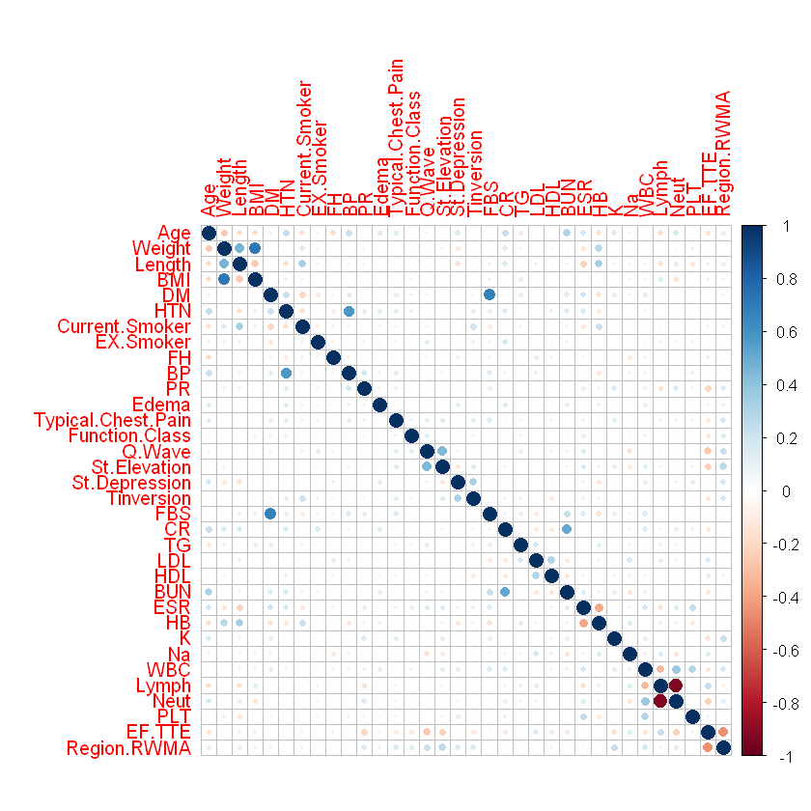
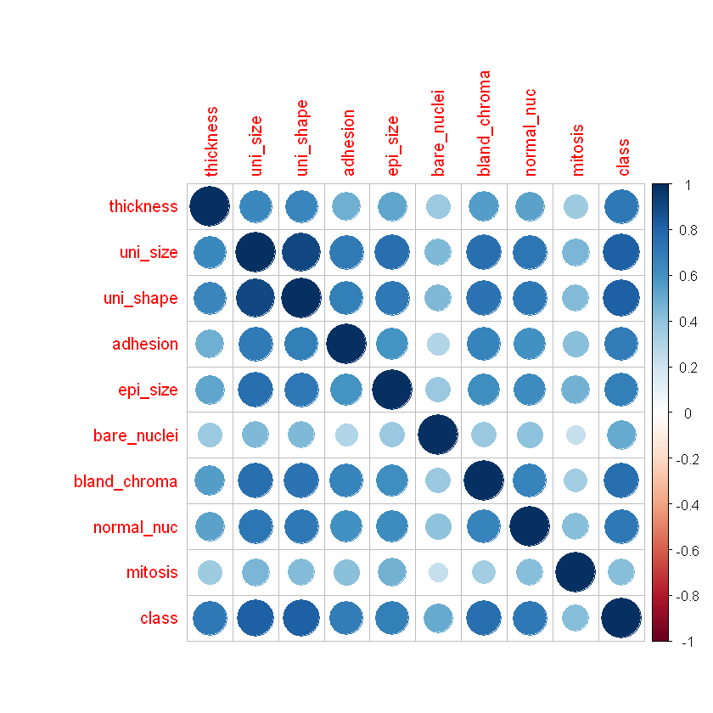
Correlation
CAD data
When there are correlated groups in the data, it is noisy data.
We can add group lasso – where we make sure to treat groups of correlated variables in the same way – if we have highly correlated data.
Breast Cancer Data
The variables are only a little correlated for the CAD data, but they are highly correlated for all of the breast cancer data
Group lasso will not be needed for the CAD data

Slide 5
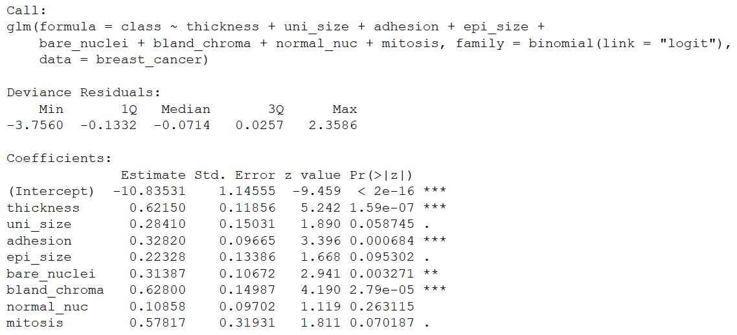
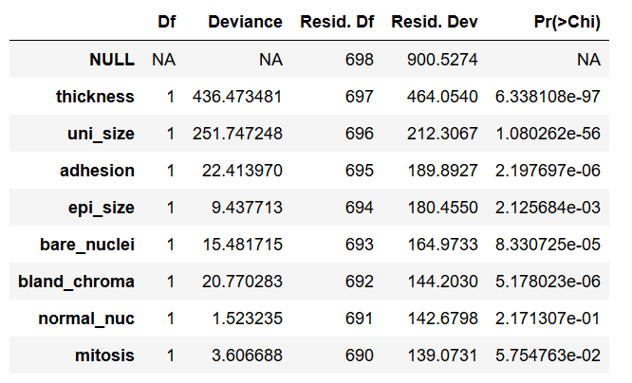
Logistic Regression with Cancer Data
After running logistic regression, I can see that not all the variables have significant p-values. Thickness, adhesion, bare nuclei, and bland chromatin are very significant.
When I run ANOVA, every variable significantly decreases the residual deviance, so all should be added to the final model.
With a threshold of .5
Sensitivity = 96.9%
Specificity = 93.3%
The model is performing well.
ANOVA

Slide 6
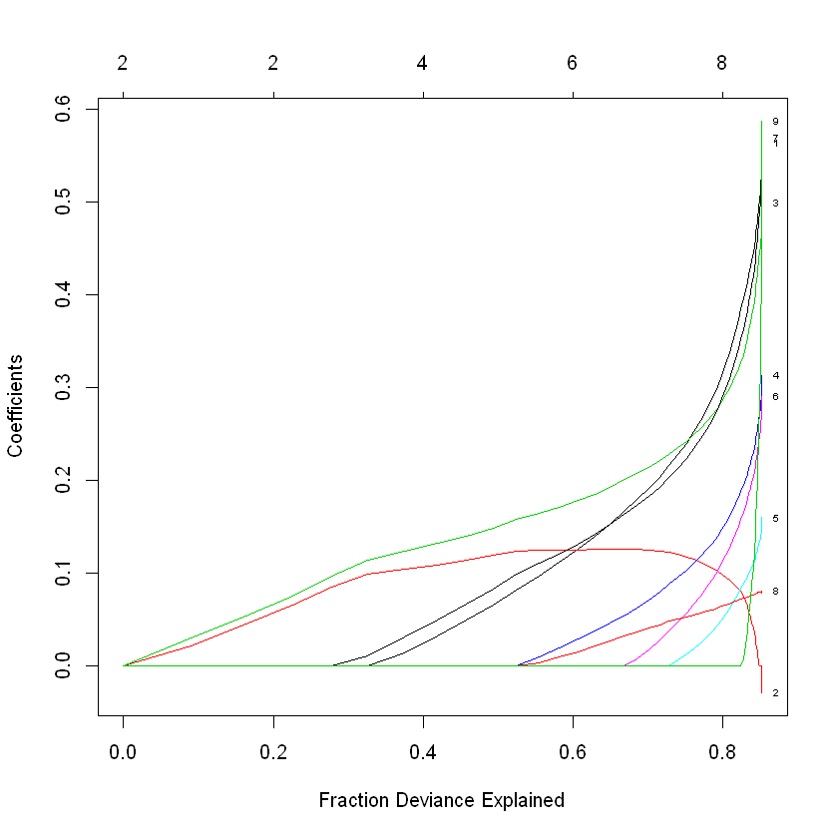
Sparse Logistic Regression with Cancer Data
I chose misclassification error as the optimizer for lambda
All of the covariates are included in the final model
Sensitivity = 97.4%
Specificity = 94.6%
The final model is the same and the sensitivity / specificity are about the same for logistic regression and sparse logistic regression.
For this dataset, since all covariates are included with both methods, logistic regression is better and simpler.

Slide 7
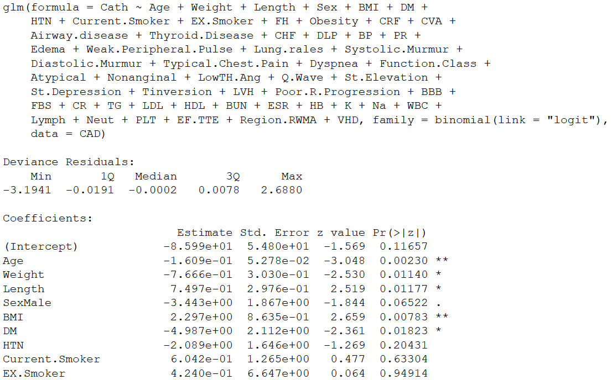
Logistic Regression with CAD Data
Only a subset of the results are posted.
There are some variables that are significant, but not all
When I run ANOVA, the results are that all 54 variables should be included.
Sensitivity = 95.8%,
Specificity = 93%
Reasonable rates, difficult to interpret model with so many covariates
It could be more useful to know a few variables that are predictive
Sparse logistic regression can make a model with less covariates

Slide 8
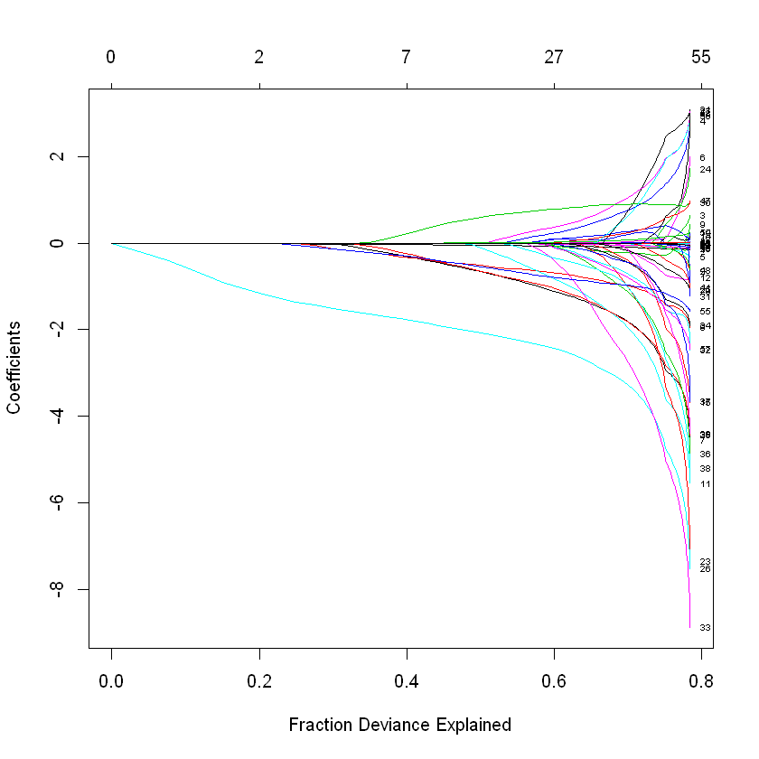
Sparse Logistic Regression with CAD Data
I chose misclassification error as the optimizer for lambda
I didn’t use group lasso
The final model includes 24 out of 54 covariates, which is much easier to interpret and use
Sensitivity = 94.9%
Specificity = 79.3%
The specificity of the model is lower, but this is not as important in a medical setting as sensitivity, which is about the same. This model may still be useful.

Slide 9
Discussion
The CAD dataset had more sparse data than the cancer dataset, but not enough to have problems with regular logistic regression
Finding a model that only needs a small number of covariates is more useful for the medical setting. It is costly and time consuming to measure things, so finding what is most useful to measure to predict an outcome is good.
A dataset where n = p or n < p would likely have more problems with accuracy and be more in need of special methods like sparse logistic regression

Slide 10
Conclusions
Sparse Logistic Regression is useful for data where n = p or n < p
It can also be useful if we have lots of parameters in our data and we want to have less in our final model
For datasets where n is much greater than p, regular logistic regression is probably better
There are also other methods that can be useful for highly correlated data like group lasso

